Slide 1
Introduction to service workers

Slide 2
Agenda
What Is a Service Worker?
What Can Service Workers Do?
Service Worker Lifecycle
Service Worker Events

Slide 3
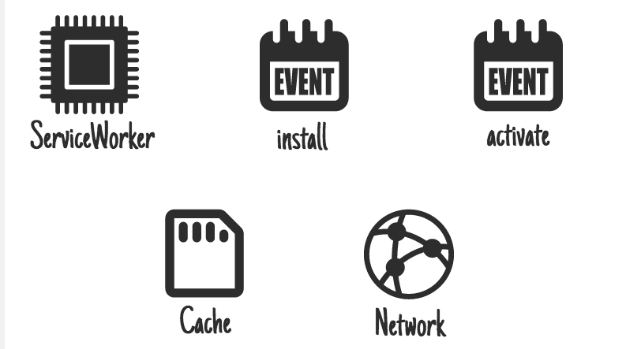
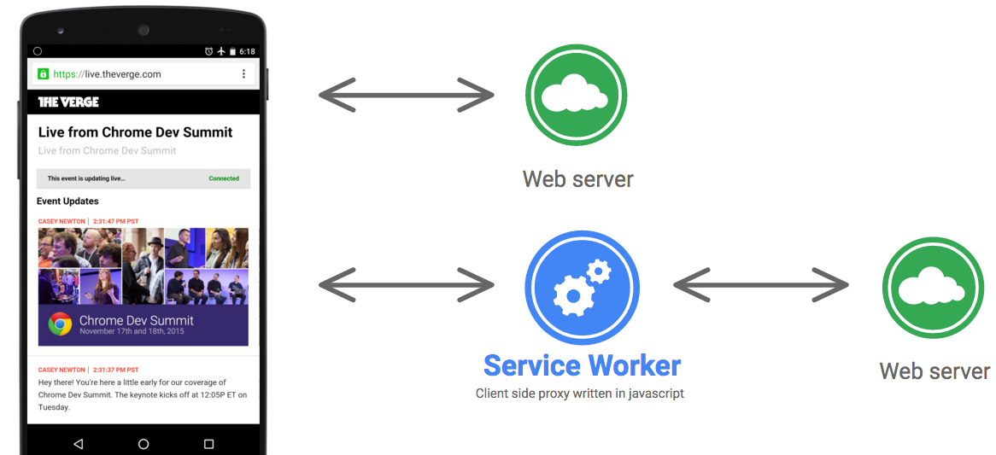
What is a service worker?
Notes:
A service worker is a client side, programmable, network proxy. It gives you fine control over the requests it handles. For example: you can control the caching behavior of requests for your site's HTML and treat them differently than requests for your site's images.
Service workers are a type of web worker, an object that executes a script separately from the main browser thread. Service workers run independent of the application they are associated with and can receive messages when not active (either because your application is in the background or not open, or the browser is closed).
The primary uses for a service workers are:
Act as a caching agent to handle network requests and store content for offline use.
Handle push messaging
The service worker becomes idle when not in use, and restarts when it's next needed. If there is information that you need to persist and reuse across restarts, then service workers can work with IndexedDB databases.
Service workers are promise based. At a high level, a promise is an object that is used as a placeholder for the eventual results of a deferred (and possibly asynchronous) computation.

Slide 4
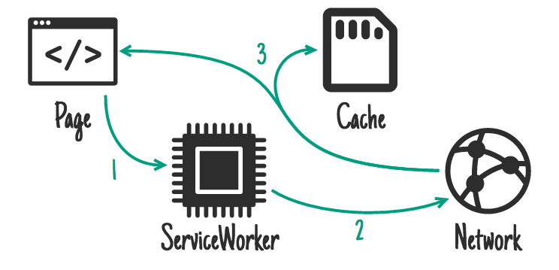
What is a service worker?
Notes:
Service workers also depend on two APIs to work effectively: Fetch (a standard way to retrieve content from the network) and Cache (a persistent content storage for application data. This cache is persistent and independent from the browser cache or network status.)

Slide 5
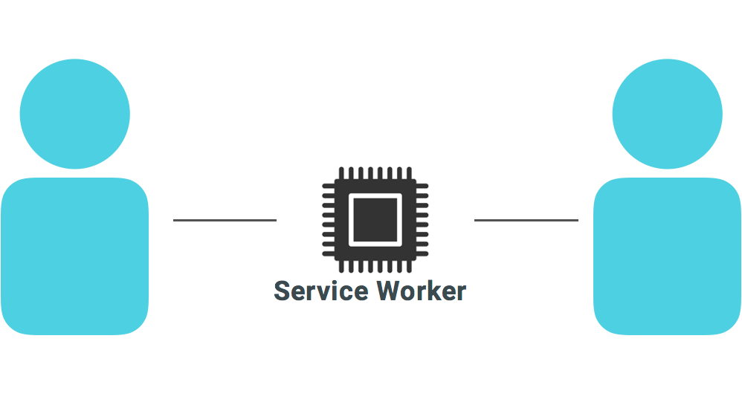
Service Worker Limitation
Notes:
Because of the power of a service worker and to prevent man-in-the-middle attacks where third parties track the content of your users’ communication with the server, service workers are only available on secure origins served through TLS, using the HTTPS protocol.
We will test service workers using localhost which is exempt from this policy.
If you’re hosting your code on Github you can use Github Pages to serve the content, they are provisioned with SSL by default.
Services like Letsencrypt allow you to procure SSL certificates for free to install on your server.

Slide 6
What can service workers do?
Response
Online
Server
Application
request
Service Worker
Offline
Offline Cache
Response
Notes:
Service workers enable applications to control network requests, cache those requests to improve performance and provide offline access to cached content.
This is just the tip of the iceberg. We will explore some things you can do with a service worker and related APIs.
Caching assets for your application in the client’s browser content will make the content load faster under most network conditions. Two specific types of caching behavior suitable for use in your service worker:
Precache Assets During Installation
If you have assets (HTML, CSS, JavaScript, images) that are shared across your application you can cache them when you first install the service worker in the client’s browser, during the install process. This technique is at the core of the Application Shell Architecture.
Note that using this technique does not preclude regular caching. We can combine the precache with regular caching.
Provide a Fallback for Offline Access
Using the Fetch API inside a Service Worker we can fetch requests and then modify the response with content other than the object requested. We can use this technique to provide alternative resources in case the requested resources are not available in cache and the network is unreachable.

Slide 7
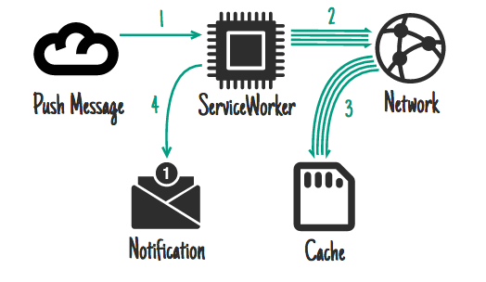
What can service workers do?
Notes:
Act As the Base for Advanced Features
Service workers are designed to work as the starting point for features that make web applications work like native apps. Some of these features are:
Channel Messaging API: Allows web workers and service workers to communicate with each other and with the host application. Examples of this API include new content notification and updates that require user interaction
Notifications API: A way to integrate push notifications from your application to the Operating System’s native notification system
Push API: An API that enables push services to send push messages to an application. Servers can send messages at any time, even when the application or the browser is not running. Push messages are delivered to a Service Worker which can use the information in the message to update local state or display a notification to the user
Background Sync lets you defer actions until the user has stable connectivity. This is useful for ensuring that whatever the user wants to send, is actually sent. This API also allows servers to push periodic updates to the app so the app can update when it’s next online

Slide 8
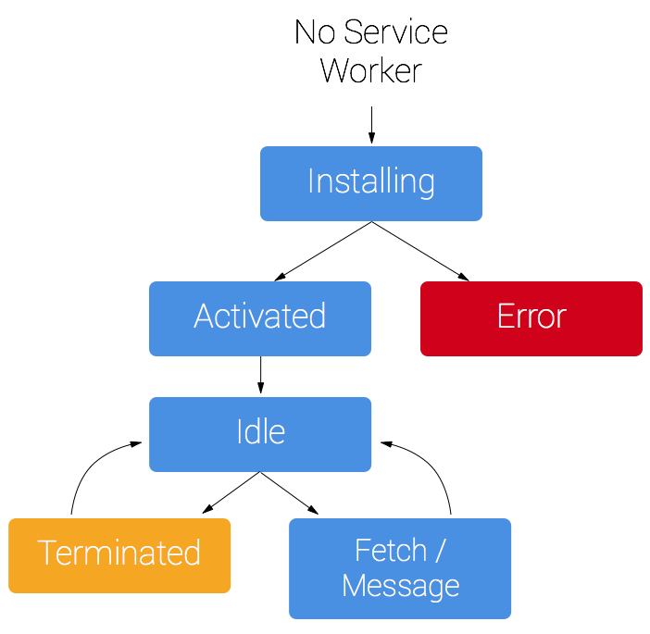
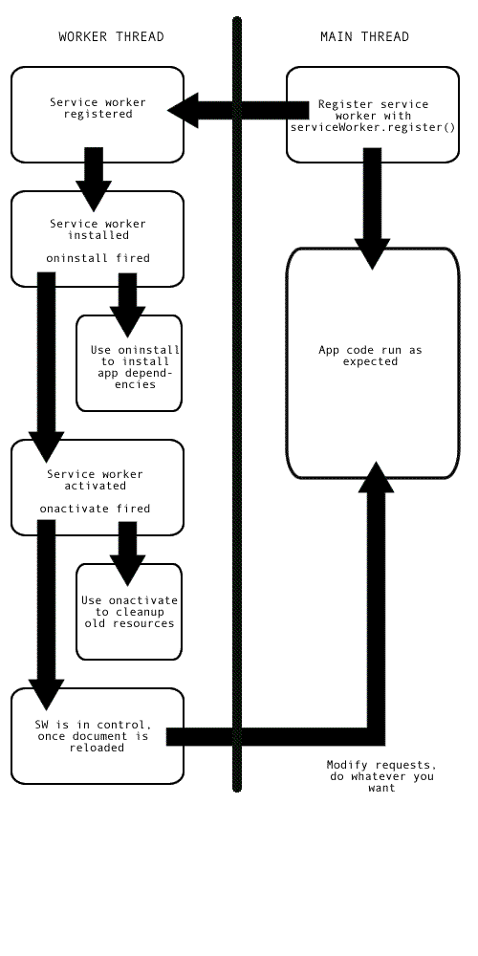
Service worker lifecycle
Notes:
Every service worker goes through three steps in its lifecycle:
Registration
Installation
Activation

Slide 9
Service worker lifecycle: Registration
if (!('serviceWorker' in navigator)) { console.log('Service Worker not supported'); return; } navigator.serviceWorker.register('/service-worker.js') .then(function(registration) { console.log('SW registered! Scope is:', registration.scope); }); // .catch a registration error
main.js
Notes:
To install a service worker, you need to register it in your main JavaScript code. Registration tells the browser where your service worker is located, and to start installing it in the background. For example, you could include a <script> tag in your site’s index.html file (or whatever file you use as your application’s entry point) with code similar to the one shown here.
This code starts by checking for browser support by attempting to find serviceWorker as a property in the navigator object. The service worker is then registered with navigator.serviceWorker.register, which returns a promise that resolves when the service worker has been successfully registered. The scope of the service worker is then logged with registration.scope.
You can attempt to register a service worker every time the page loads, and the browser will only complete the registration if the service worker is new or has been updated.

Slide 10
Service worker scope
navigator.serviceWorker.register('/service-worker.js', { scope: '/app/' });
main.js
Notes:
The scope of the service worker determines from which path the service worker will intercept requests. The default scope is the path to the service worker file, and extends to all lower directories. So if the service worker script (for example service-worker.js) is located in the root directory, the service worker will control requests from all files at this domain.
You can also set an arbitrary scope by passing in an additional parameter when registering.
In this case we are setting the scope of the service worker to /app/, which means the service worker will control requests from pages like /app/, /app/lower/ and /app/lower/lower, but not from pages like /app or /, which are higher.
A service worker cannot have a scope above its own path.

Slide 11
Service worker lifecycle: Installation
self.addEventListener('install', function(event) { // Do stuff during install });
service-worker.js
Notes:
This is in your service worker file: service-worker.js.
Installation
Once the the browser registers a service worker, the install event can occur.
This event will trigger if the browser considers the service worker to be new, either because this is the first service worker encountered for this page, or because there is a byte difference between the current service worker and the previously installed one.
We can add an install event handler to perform actions during the install event.
The install event is a good time to do stuff like caching the App Shell or static assets using the Cache API.

Slide 12
Service worker lifecycle: Activation
self.addEventListener('activate', function(event) { // Do stuff during activate });
service-worker.js
Notes:
If this is the first encounter of a service worker for this page, the service worker will install and, if successful, transition to the activation stage upon success.
Once activated, the service worker will control all pages that load within its scope, and intercept corresponding network requests.
However the pages in your app that are open will not be under the service worker’s scope since the service worker was not loaded when the pages opened. To put currently open pages under service worker control you must reload the page or pages. Until then, requests from this page will bypass the service worker and operate like they normally would.
Service workers maintain control as long as there are pages open that are dependant on that specific version. This ensures that only one version of the service worker is running at any given time.
If a new service worker is installed on a page with an existing service worker, the new service worker will not take over until the existing service worker is removed. Old service workers will become redundant and be deleted once all pages using it are closed. This will activate the new service worker and allow it to take over.
Refreshing the page is not sufficient to transfer control to a new service worker, because there won’t be a time when the old service worker is not in use.
The activation event is a good time to clean up stale data from existing caches for the application.
Note: activation of a new service worker can be forced programatically with self.skipWaiting.

Slide 13
Service worker events
Events | Functional Events
install | fetch
activate | sync
message | push
Notes:
Service workers are event driven.
Installation and activation events fire off corresponding events to which the service worker can respond.
The install event is when you should prepare your service worker for use, e.g. by creating a cache and adding assets to it.
The activate event is a good time to clean up old caches and anything else associated with a previous version of your service worker.
The service worker can receive information from other scripts through message events. There are also functional events such as fetch, push, and sync the service worker can respond to.
To examine service workers, navigate to the Service Worker section in your browser’s developer tools. Different browsers put the tools in different places. Check Debugging Service Workers in Browsers for instructions for Chrome, Firefox and Opera.

Slide 14
Service worker responds to fetch
self.addEventListener('fetch',
function(event) {
event.respondWith(
caches.match(event.request)
);
});
service-worker.js
Notes:
A fetch event is fired every time a resource is requested. In this example we listen for the fetch event, and instead of going to the network, return the requested resource from the cache (assuming it is there).

Slide 15
Service worker and background sync
navigator.serviceWorker.register('/sw.js');
// Later request a one-off sync:
navigator.serviceWorker.ready.then(function(swRegistration) {
return swRegistration.sync.register('foo');
});
main.js
Notes:
Service workers can use background sync
Here we start by registering the service worker.
Once the service worker is ready, we register a sync event with the tag 'foo'

Slide 16
Service worker respond to sync
self.addEventListener('sync', function(event) {
if (event.tag === 'foo') {
event.waitUntil(doSomething());
}
});
service-worker.js
Notes:
The service worker can listen for sync events.
This example listens for the sync event tagged 'foo' in the previous slide.
doSomething() should return a promise indicating indicating the success/failure of whatever it’s trying to do. If it fulfills, the sync is complete. If it fails, another sync will be scheduled to retry. Retry syncs also wait for connectivity, and employ an exponential back-off.

Slide 17
Service worker respond to push
// var options = {...}
self.addEventListener('push', function(event) {
event.waitUntil(
self.registration.showNotification('Hello!', options);
);
});
service-worker.js
Notes:
The service worker can listen for push events. Push events are initiated by your backend servers, through a browser's push service.
This example shows a notification when the push event is received. The options object is used to customize the notification. The notification could contain the data that was pushed from the servers.

Slide 18
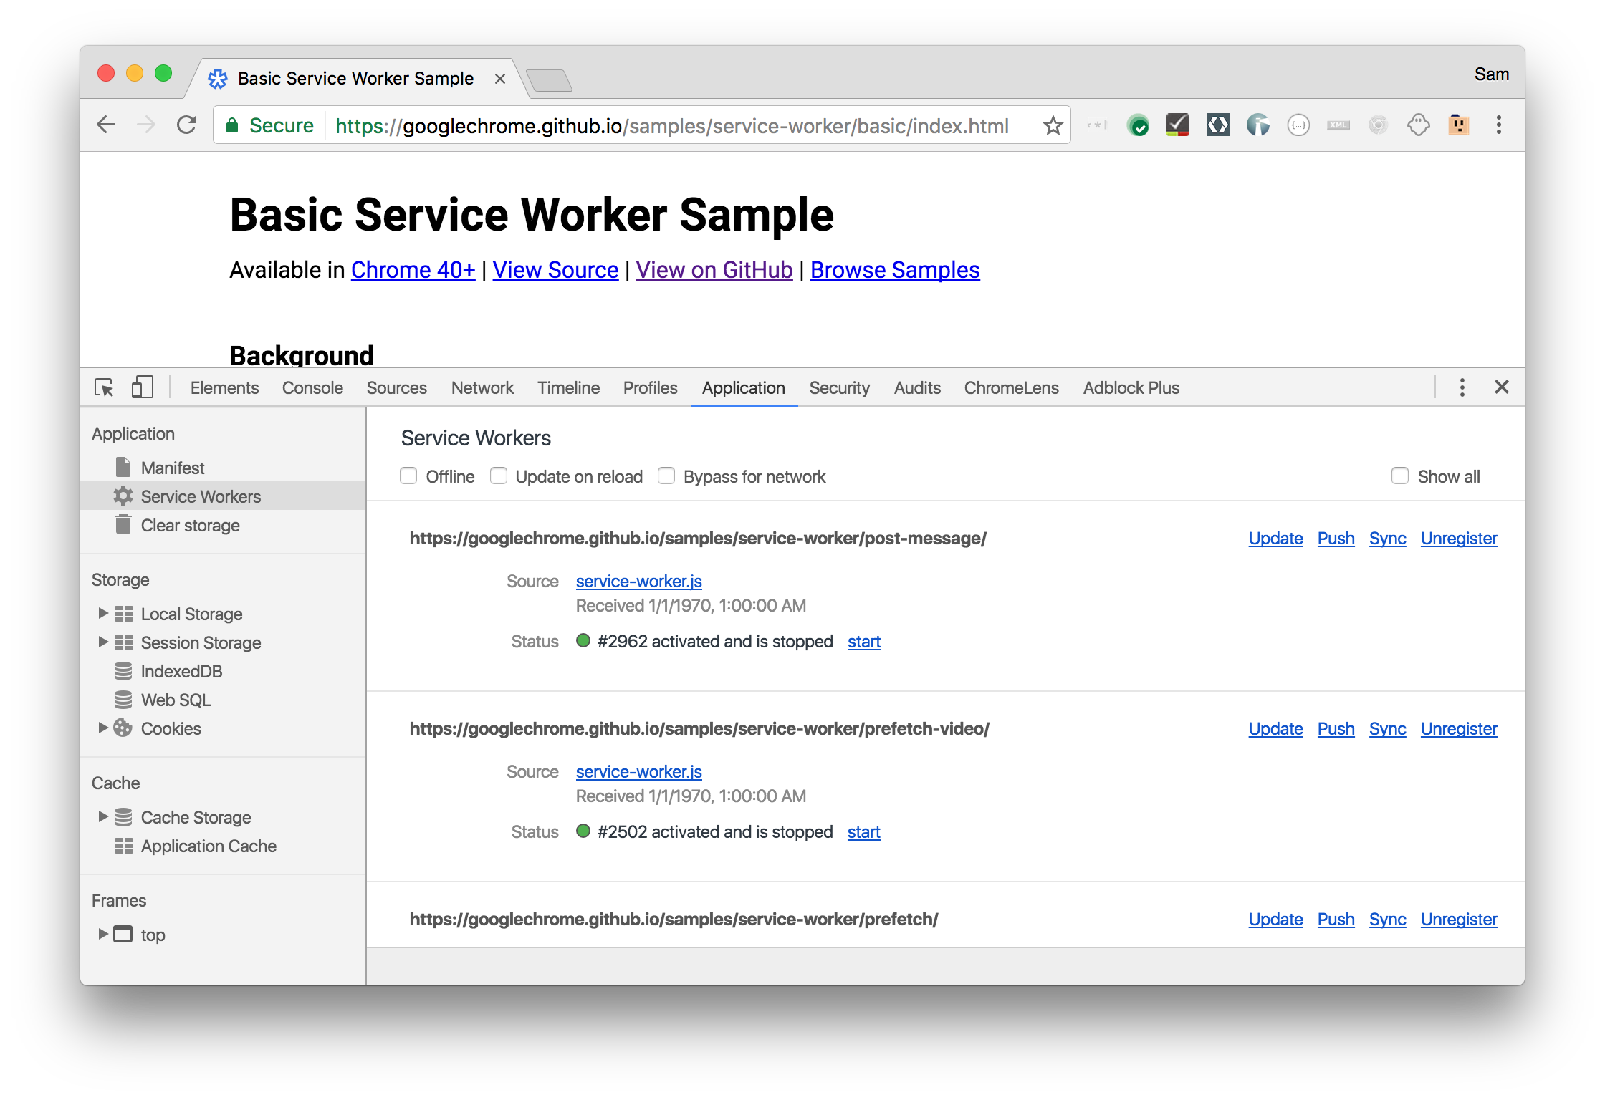
Notes:
Service workers can be tested and debugged in the supporting browsers developer tools (Chrome shown).

Slide 19
Resources
Service workers: an introduction
Service workers in production
The Service Worker API
Using service workers

Slide 20
Lab Overview
Create and register a service worker
Learn about the service worker lifecycle
Intercept network requests
Learn about service worker scope

